Slide 1
MOLECULAR BASIS OF INHERITANCE
Unit-VII : Genetics and Evolution
Chapter 5
Ms. Sarojmoni Sonowal
Assistant Professor
Department of Zoology
Pub Kamrup College

Slide 2
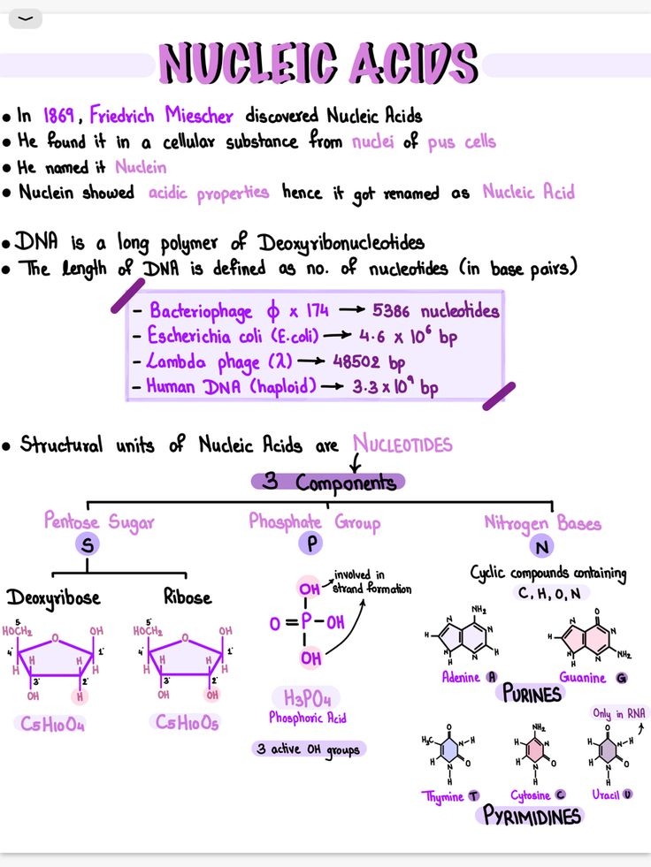


DNA (Deoxyribonucleic acid)

Slide 3
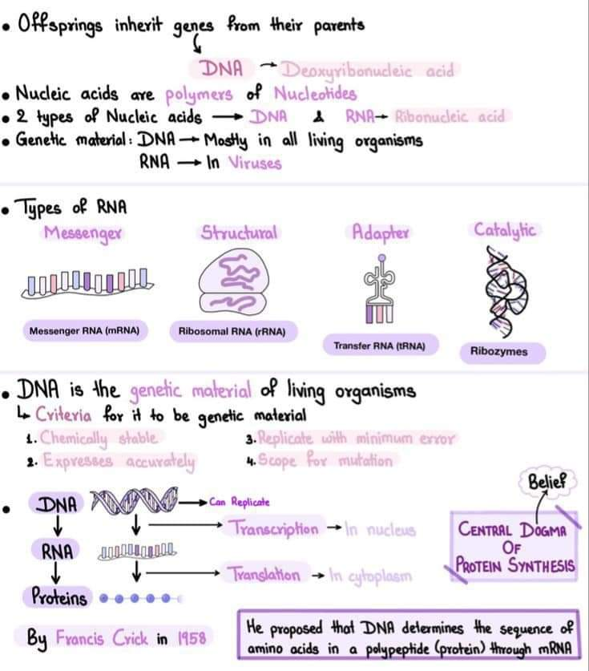

Slide 4
STRUCTURE OF POLYNUCLEOTIDE CHAIN

Slide 5
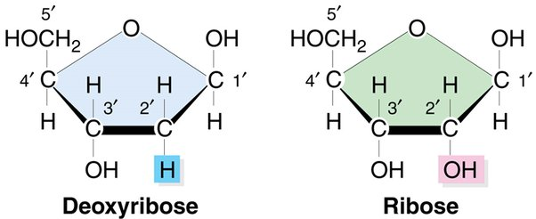
COMPONENT 1: SUGAR
Deoxyribose Sugar Present in DNA
Ribose Sugar Present in RNA

Slide 6
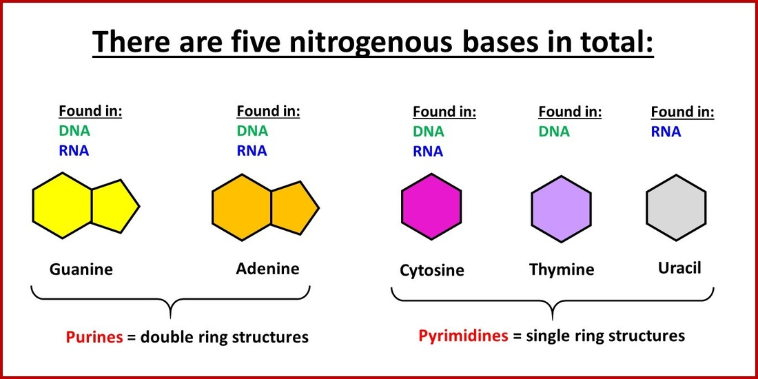
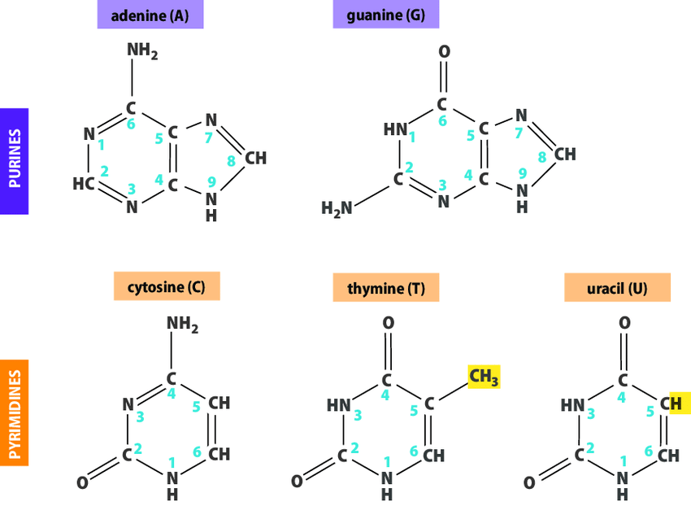






COMPONENT 2: NITROGENOUS BASE

Slide 7
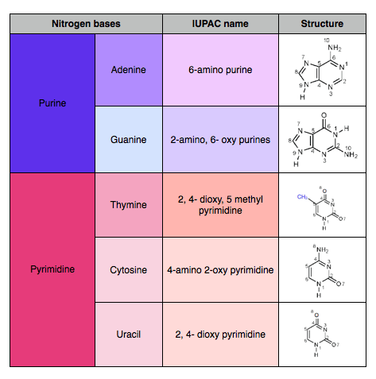

Slide 8
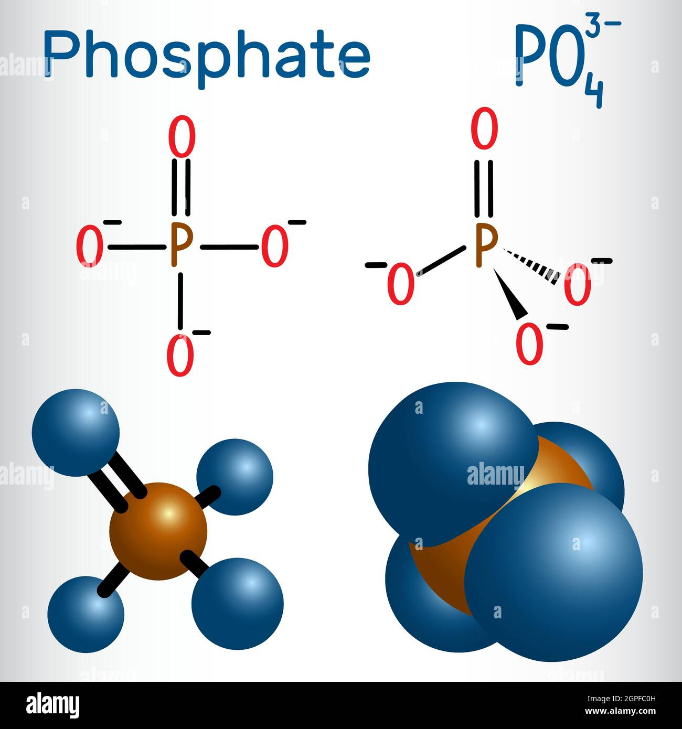
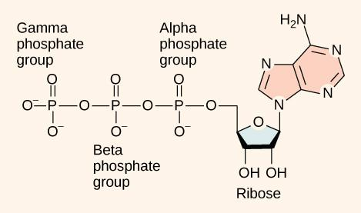



COMPONENT 3:
PHOSPHATE GROUP

Slide 9
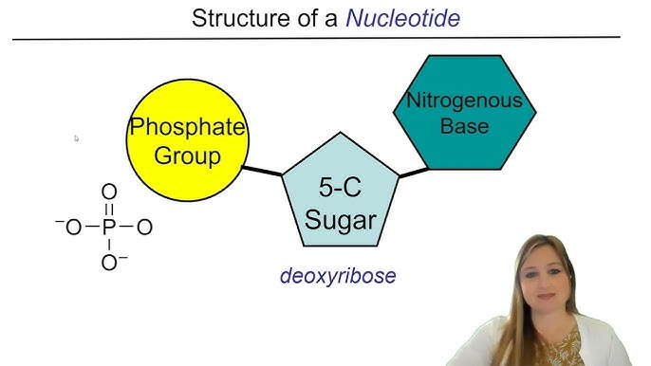
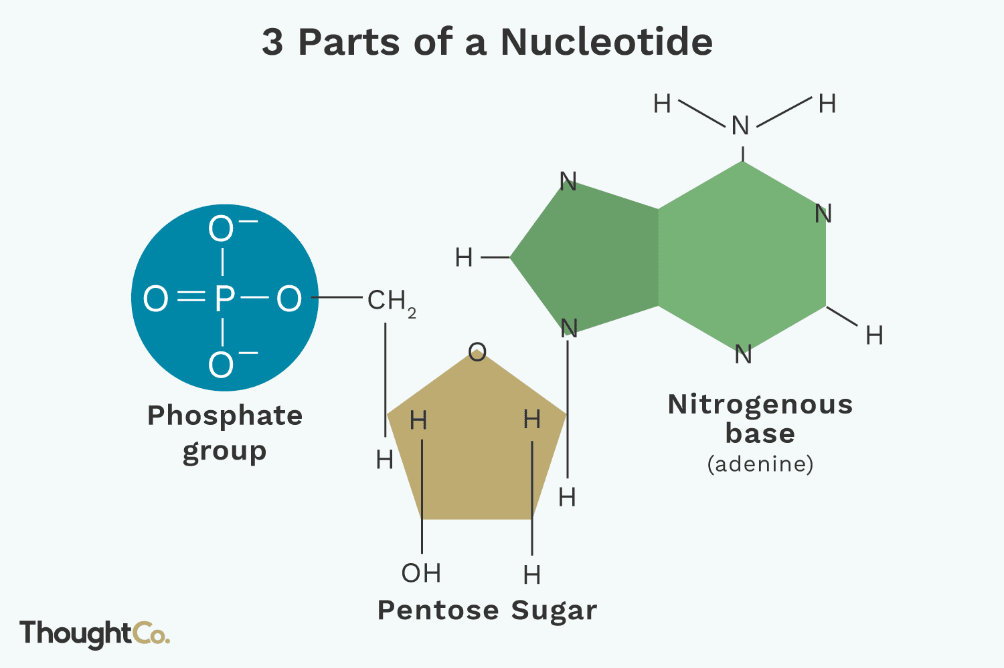
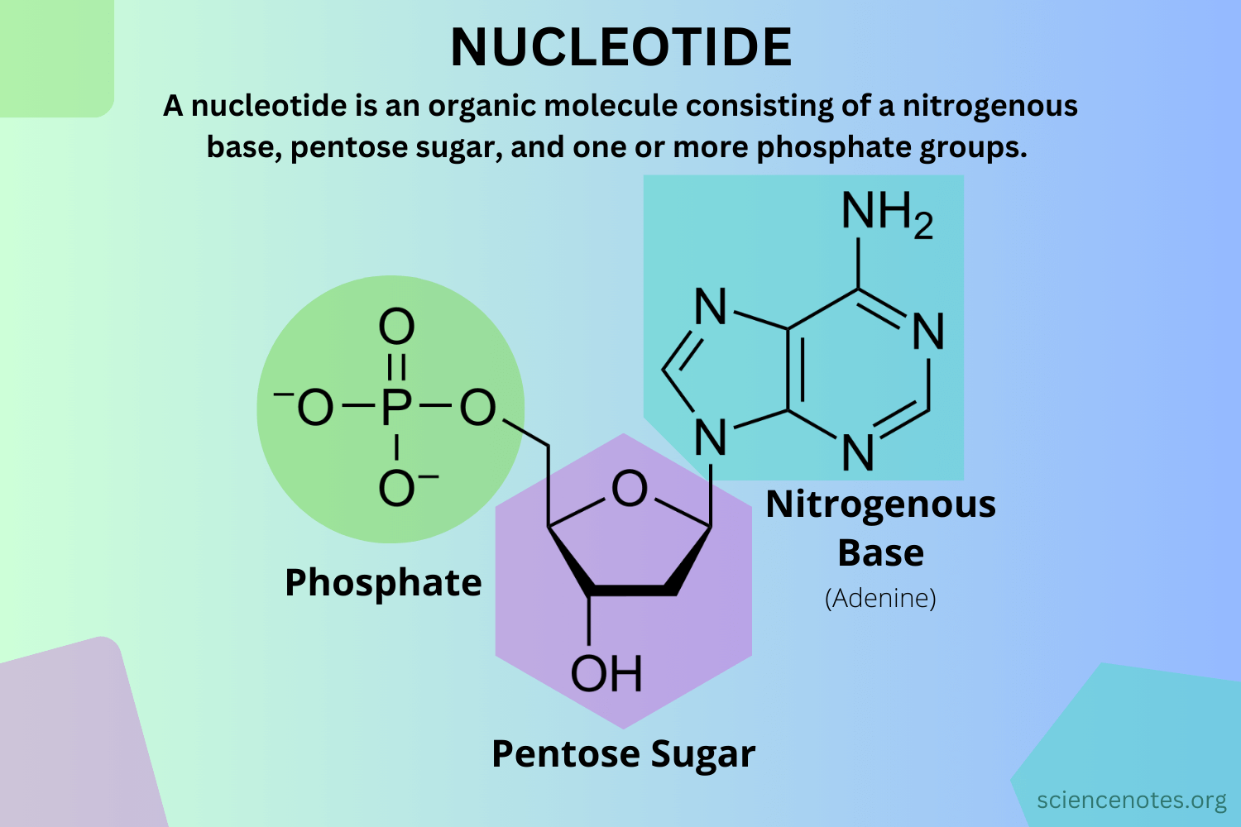
3 Parts
Or
Components Combine To Form A Nucleotide

Slide 10
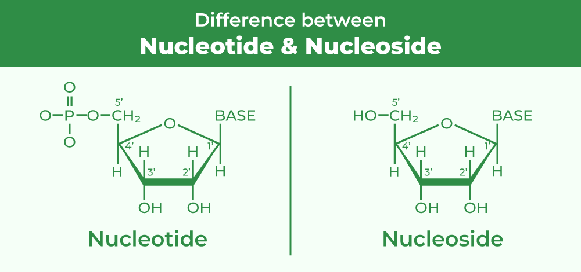

Slide 11
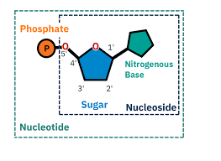
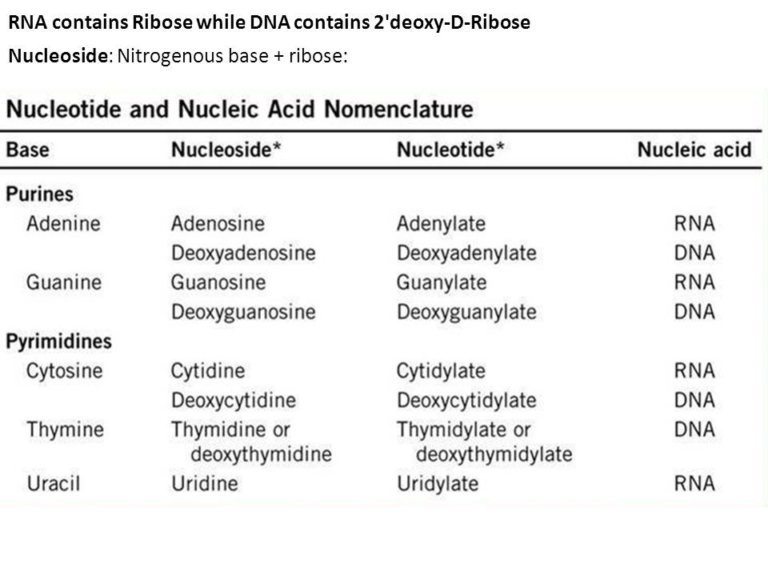
NUCLEOSIDE AND NUCLEOTIDE

Slide 12
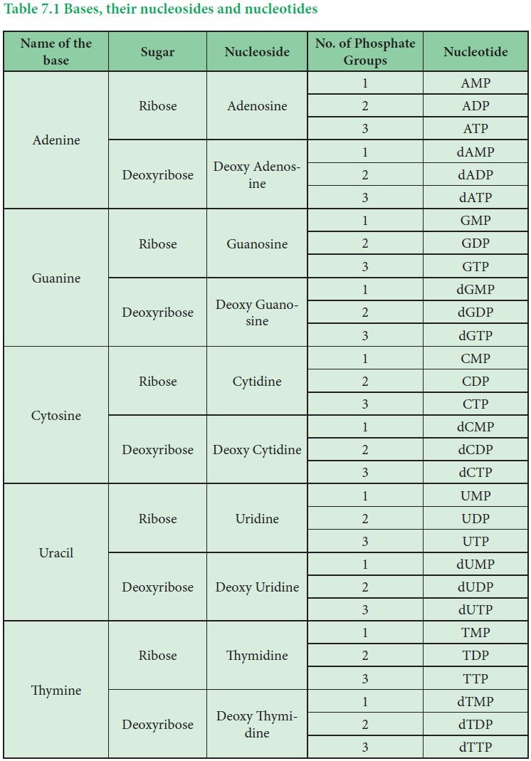
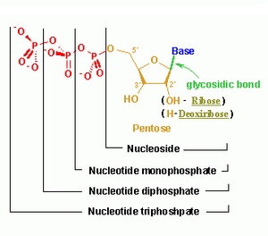

Slide 13
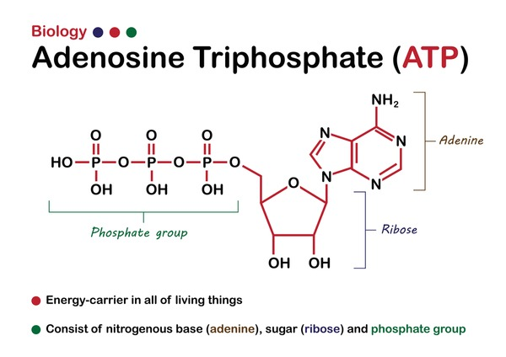
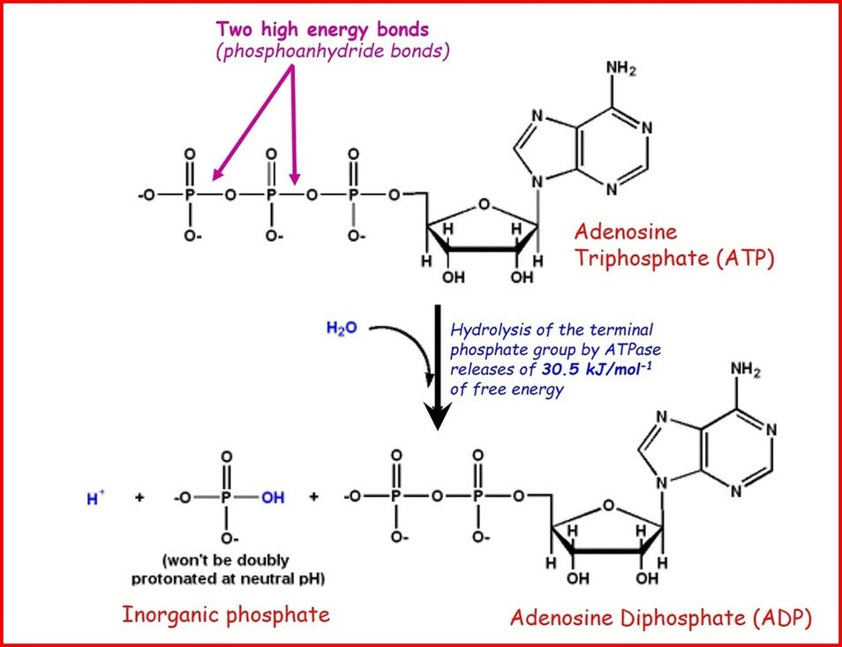


EXAMPLE OF A NUCLEOTIDE

Slide 14
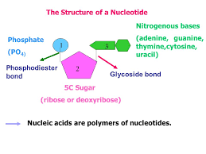
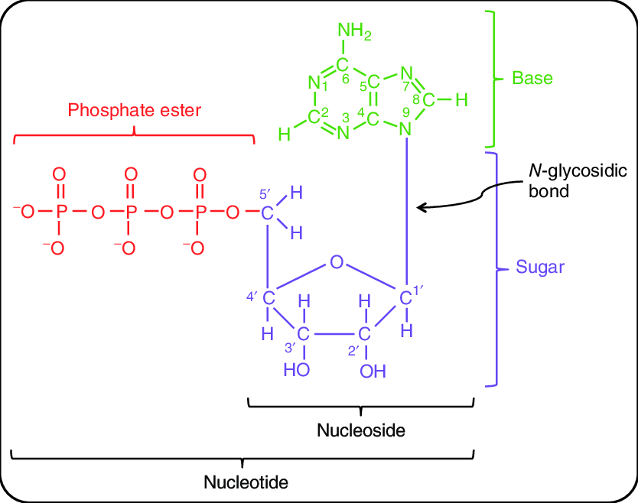



Linkages or Bonds present in a Nucleotide

Slide 15
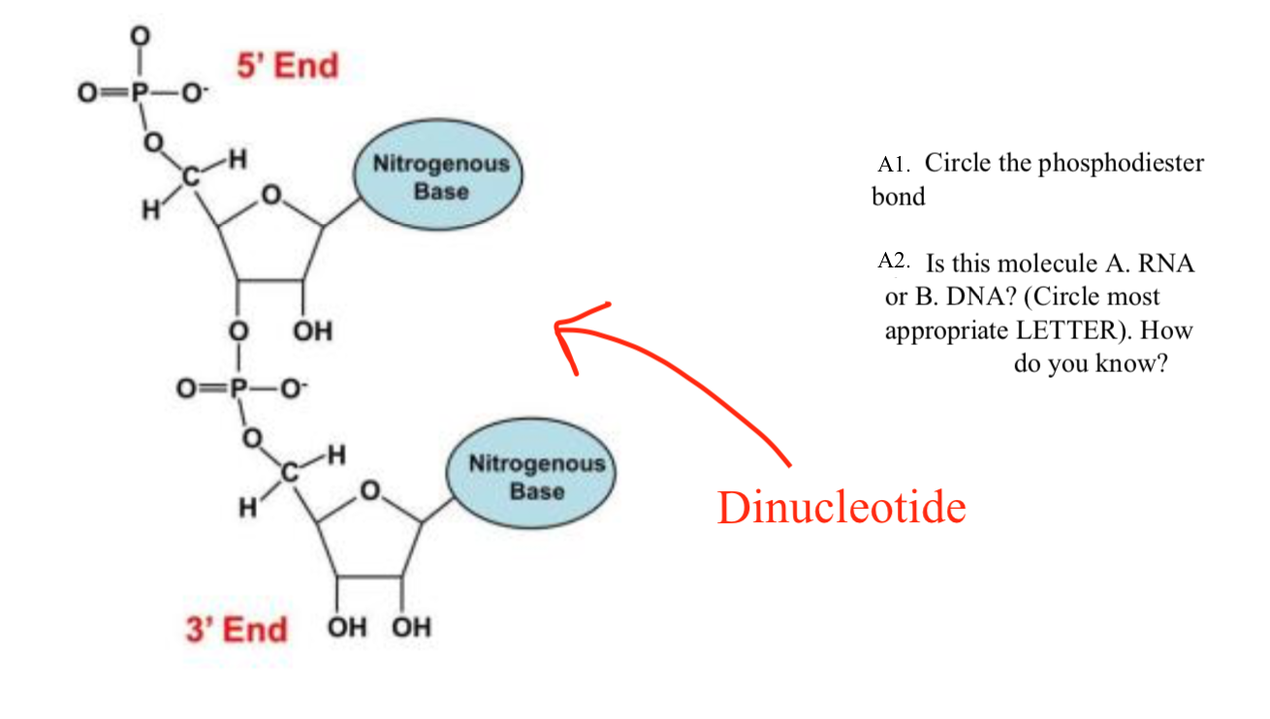
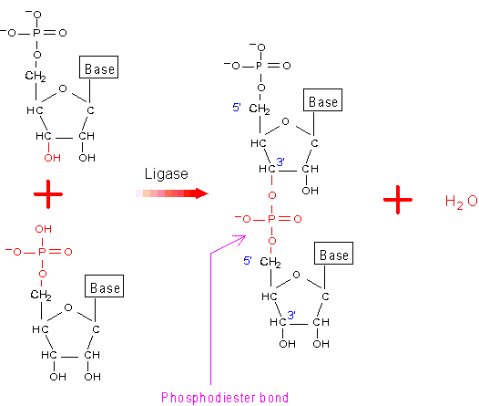


Dinucleotide

Slide 16
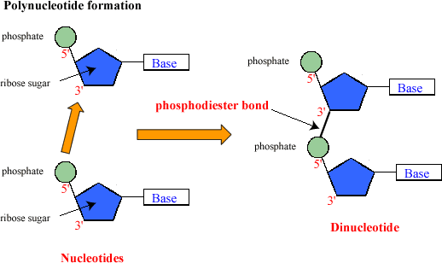
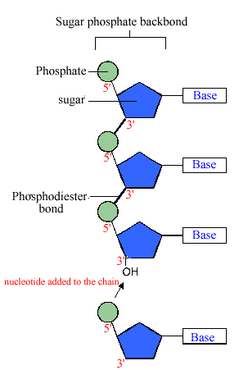

POLYNUCLEOTIDE CHAIN FORMATION & BOND

Slide 17
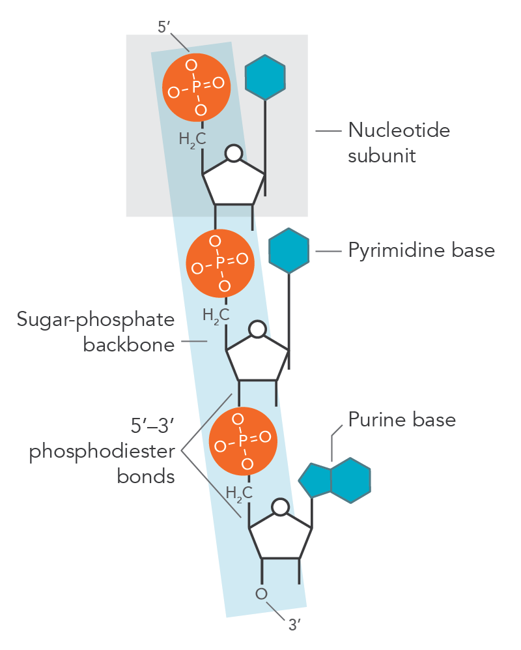
POLYNUCLEOTIDE CHAIN
(2 free ends)
5’ end
3’ end

Slide 18
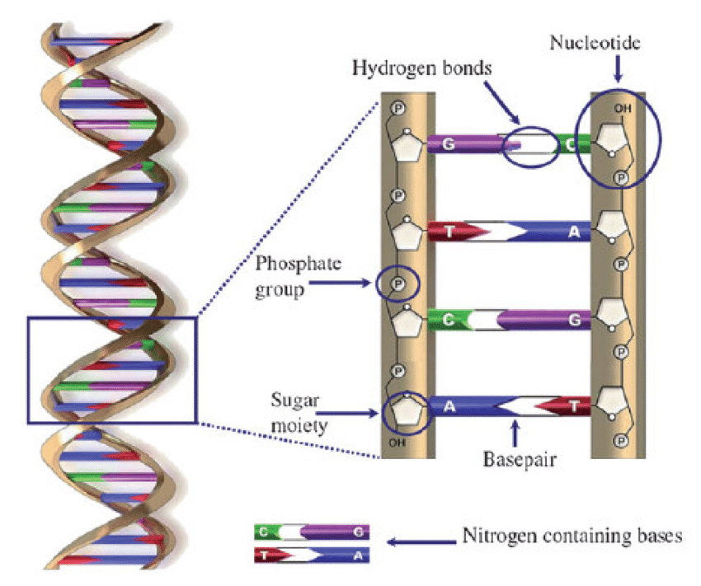
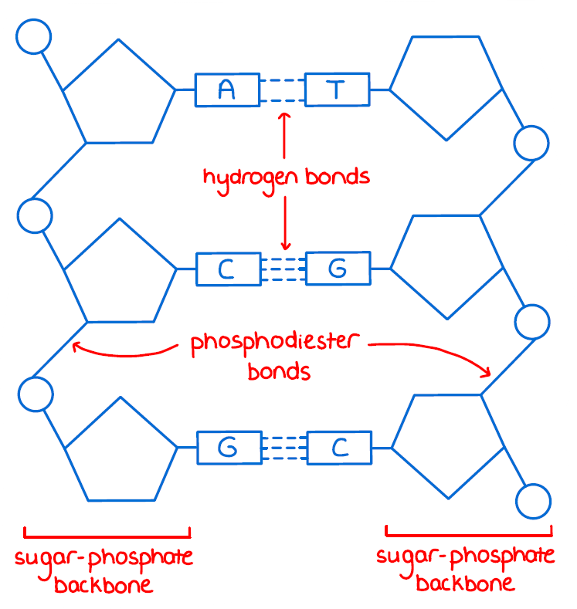


Bonds present in a DNA

Slide 19
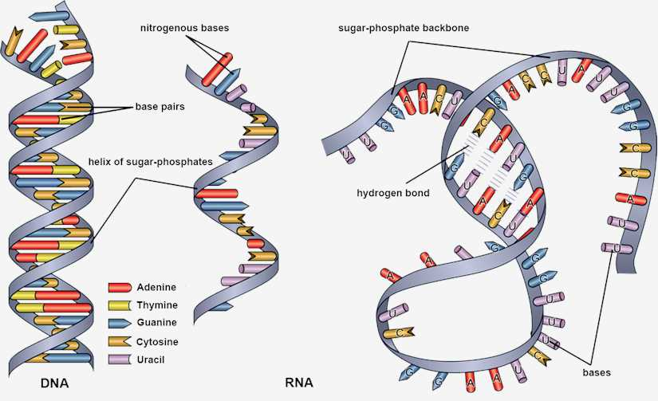
RNA (Ribonucleic Acid)

Slide 20
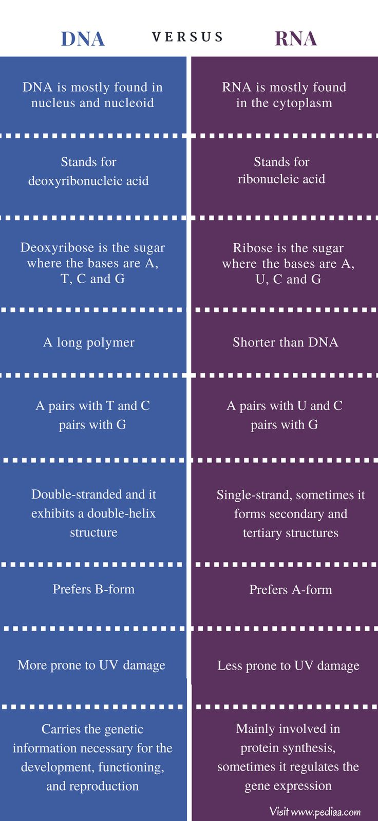
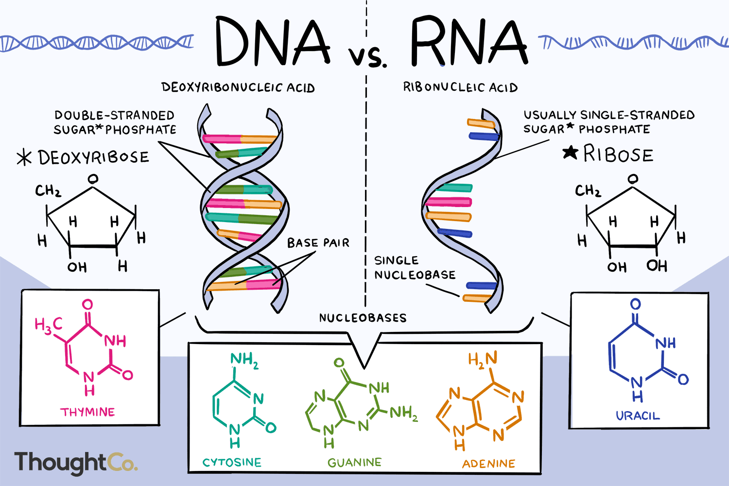

Slide 21
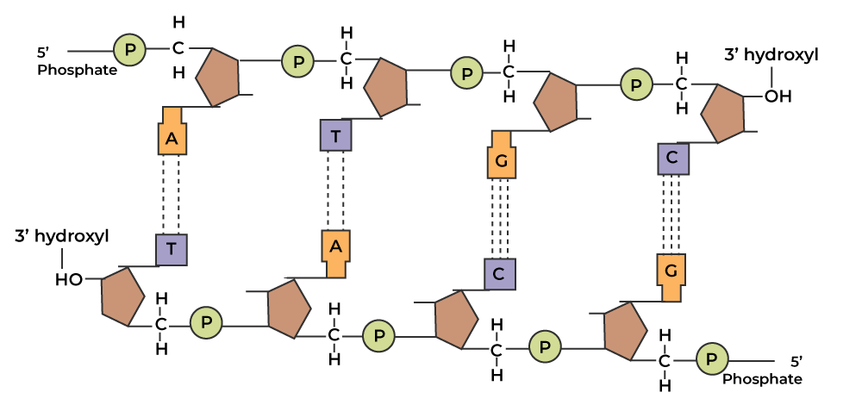
DNA
Backbone of Polynucleotide chain (Phosphate & Sugar)

Slide 22
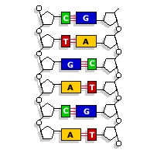
DNA as an acidic substance present in nucleus was first identified by F. Miescher in 1869. However, due to limitation in isolation of such a long polymer intact, structure of DNA remain elusive for a long time.
It was only in 1953, James Watson and Francis crick based on the X-ray diffraction data produce by Maurice Wilkins & Rosalind Franklin, proposed the famous double helix model of structure of DNA.
Proportion of the base pairing between 2 strands of polynucleotide chains was based on observation of Erwin Chargaff.
(Ratio between A & T, G & C are constant and equal)
Base pairs are complementary to each other.
Therefore, if the sequence of one strand is known. The other strand sequence can be predicted. Because of this, the structure of DNA became clear.

Slide 23
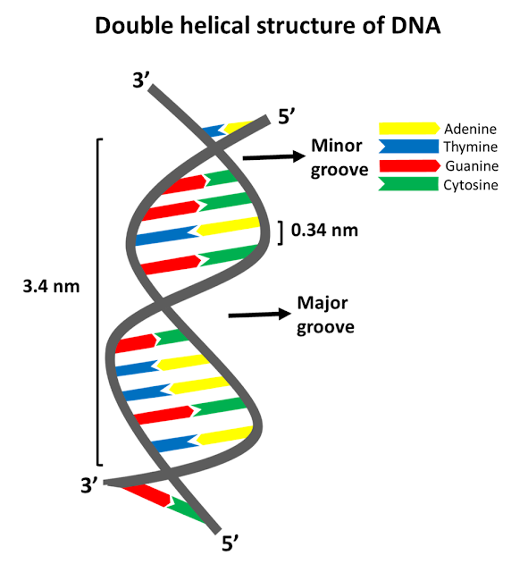
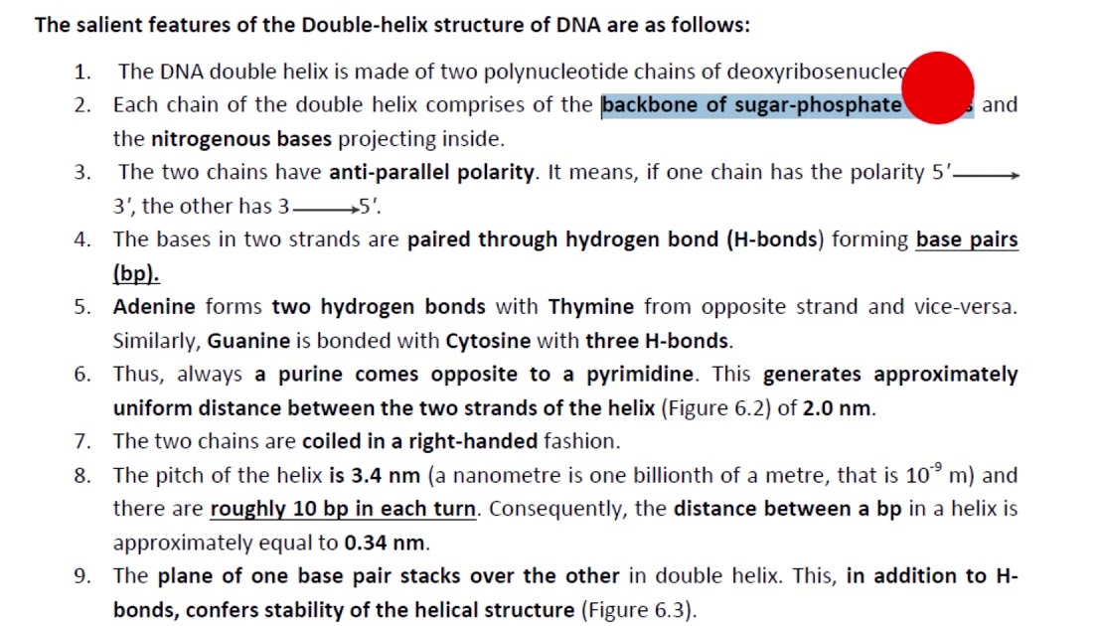




Watson and Crick DNA

