Slide 1
Individuals,communities and collective outcomes

Slide 2
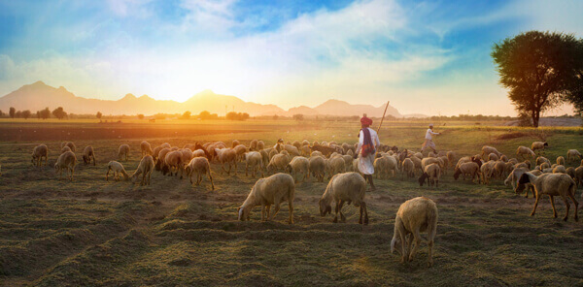
Models
threatened destruction of a valuable natural resource
Even after knowing the basic reason, people concerned cannot agree on how to solve the problem
Tragedy of Commons
Prisoner’s Dilemma
Collective Actions

Slide 3
Tragedy of commons
symbolize the degradation of the environment to be expected whenever many individuals use a scarce resource in common
receives the direct benefit and bears only a share of the costs (delayed costs from the deterioration or the commons).
Eg: Garret Hardin’s example of open pasture
Aristotle long ago observed that "what is common to the greatest number has the least care bestowed upon it
Hobbes — Men seeks for their own good and ends up fighting each other

Slide 4
Prisoner's dilemma
Prisoner's dilemma game is conceptualized as non cooperative game in which all players possess complete information
In noncooperative games, communication among the players is forbidden or impossible or simply irrelevant as long as it is not explicitly modeled as part of the game
In a prisoner's dilemma game, each player has a dominant strategy in the sense that the player is always better off choosing this strategy ( here: to defect)
When both players choose their dominant strategy, given these assumptions, they produce an equilibrium that is the third-best result for both
The equilibrium result­ing from each player selecting his or her "best" individual strategy is, however, not a Pareto-optimal outcome

Slide 5
Formalising Hardin’s model
Players: herders in an open grazing land with upper limit ‘L’ : 2 person game
2 strategies: Cooperate and defect
for each herder to graze as many animals as he thinks he can sell at a profit (given his private costs), assuming that this number is greater than L/2.
grazing L/2 animals for each herder

Slide 6
The paradox that individually rational strategies lead to collectively irrational outcomes seems to challenge a fundamental faith that rational human beings can achieve rational results
Cooperate
Defect
10, 10 | -1, 11
11,-1 | 0,0
Cooperate
Defect

Slide 7
The logic of Collective Action
Developed by Mancur Olson in 1965 —— the difficulty of getting individuals to pursue their joint welfare, contrasted to individual welfare
challenge the grand optimism expressed in group theory: “that individuals with common interests would voluntarily act so as to try to further those interests”
“unless the number of individuals is quite small, or unless there is coercion or some other special device that make individuals act in their common interest, rational, self interested individuals will not act to achieve their, common or group interests.” Olson

Slide 8
one who cannot be excluded from obtaining the benefits of a collective good once the good is produced has little incentive to contribute voluntarily to the provision of that good
de­fined the accepted way of viewing many problems that individuals face when attempting to achieve collective benefits
explaining how perfectly rational individuals can produce. under some circumstances, outcomes that are not "rational" when viewed from the perspective of all those involved.

Slide 9
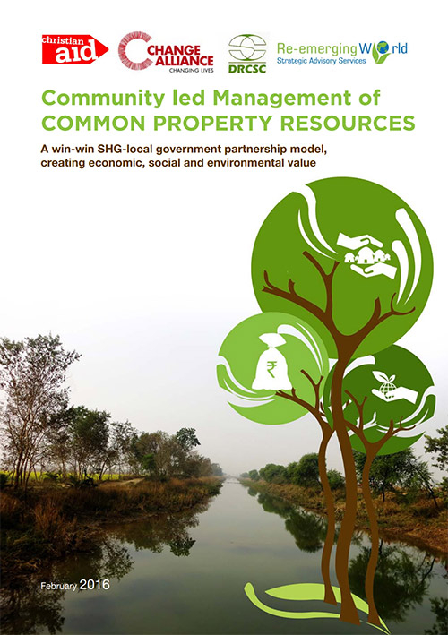
Policy prescriptions
Leviathan as the "only way”
external Leviathan is necessary to avoid trag­edies of the commons leads to recommendations that central governments control most natural resource systems
2. Privatization as the "only way”
the only way to avoid the tragedy of the commons in natural resources and wildlife is to end the common-property system by creating a system of private property rights
3. The “only way”?
Successful CPR institutions -rich mixture. of "private-like" and "public-like- institutions
“Successful” —institutions that enable individuals to achieve productive outcomes in situations where temptations to free-ride and shirk are ever present.

Slide 10
Leviathan as the only way
common property re­sources require public control if economic efficiency is to result from their development
The presumption that the external Leviathan is necessary to avoid trag­edies of the commons leads to recommendations that central governments control most natural resource systems.
The policy advice to centralize the control and regulation of natural resources, such as grazing lands, forests, and fisheries, has been followed extensively, particularly in Third World countries.

Slide 11
Illustration 1: game with full information by the leviathan
The central agency knows the sustainable yield of the meadow (L) and can unfailingly discover and penalise any herder using the defect strategy
based on assumptions concerning the accuracy of information. monitoring capabilities, sanctioning reliability, and zero costs of administration
Now, the solution to Game 2 is (cooperate, cooperate). Both players receive 10 profit units each rather than the zero units they would have received

Slide 12
Game with complete information by the levitation
Cooperate
Defect
10, 10 | -1, 9
9, -1 | -2, -2
Cooperate
Defect

Slide 13
Illustration 2:game with incomplete information
(complete information about the carrying capacity, but incomplete information about the particular actions of the herders)
Therefore makes errors in imposing punishment
assume that the central agency punishes defections (the correct response) with probability y and fails to punish defections as probability 1-y (the erroneous response)
also assume that the central agency punishes cooperative actions (the erroneous response) with probability x and does not punish cooperative actions (the correct response) with probability 1-x

Slide 14
If the central agency does not have complete information about the actions of the herd­ers, it imposes both types of sanctions correctly with a probability of 0.7. (x=0.3; y= 0.7)
Cooperate
Defect
10-2x, 10-2x | 11-2y, -2-2x
-1-2x, 11-2y | -2y, -2y
Cooperate
Defect

Slide 15
game in which a central agency sanctions correctly with a probability of 0.7, the equilibrium outcomes are (-1.6, -1.6)
Cooperate
Defect
9.4, 9.4 | 9.6, -1.6
-1.6, 9.6 | -1.4, -1.4
Cooperate
Defect

